Slide 1
Named Entity Recognition
N-to-N Sequence Generation

Slide 2
LSTM vs GRU
Researchers have proposed many gated RNN variants, but LSTM and GRU are the most widely used
Rule of thumb: LSTM is a good default choice (especially if your data has particularly long dependencies, or you have lots of training data); Switch to GRUs for speed and fewer parameters.

Slide 3
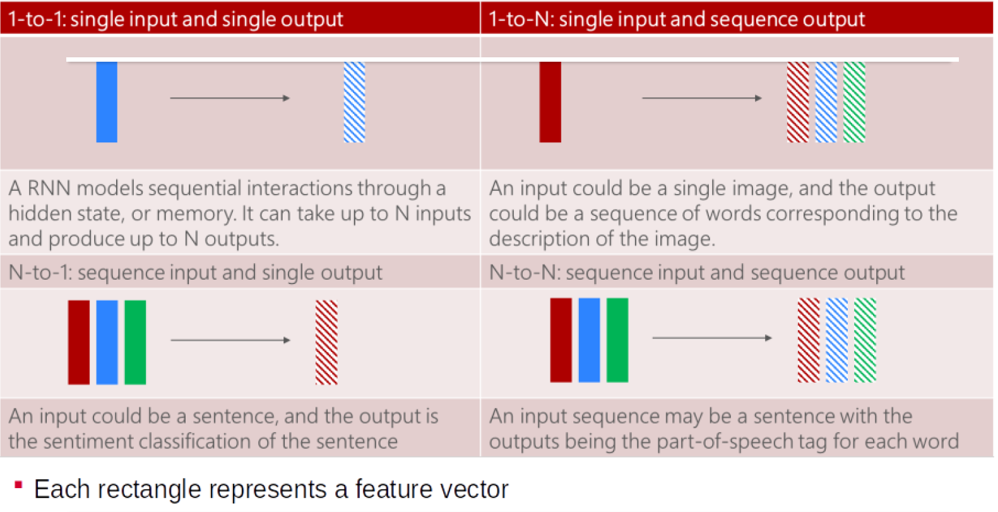
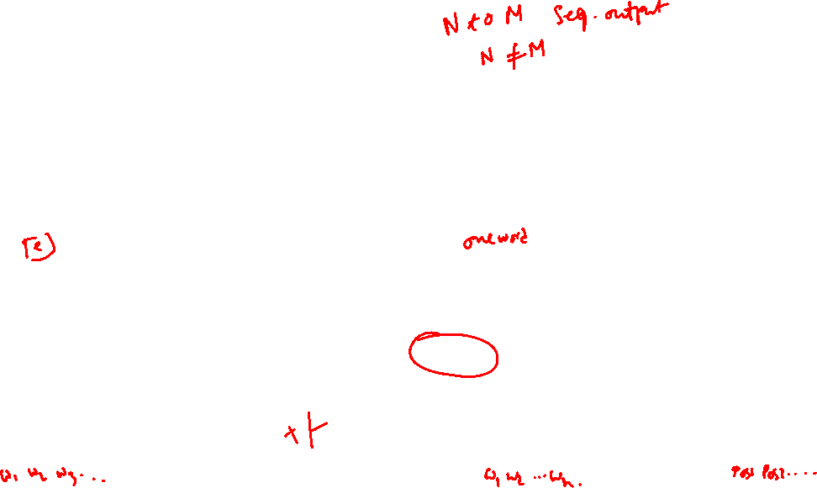
Types of RNN

Slide 4

What is NER ?
NER involves identification of proper names in texts, and classification into a set of predefined categories of interest.
Three universally accepted categories:
Person, location and organisation
Other common tasks: recognition of date/time expressions, measures (percent, money, weight etc), email addresses etc.
Other domain-specific entities: names of Drugs, Genes, medical conditions, names of ships, bibliographic references etc.

Slide 5
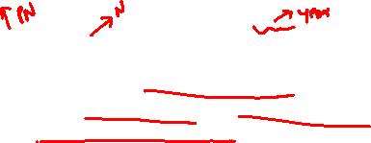
NER Definition
Named entity recognition (NER) (also known as entity identification (EI) and entity extraction) is the task that locate and classify atomic elements in text into predefined categories such as the names of persons, organizations, locations, expressions of times, quantities, monetary values, percentages, etc.
John sold 5 companies in 2002.
An episode of subacute encephalopathy after the infusion of a moderate dose of methotrexate (1500 mg/m2) (MTX) is reported in a young adult with metastastic gastric cancer.
The new quinolone derivatives (levofloxacin, sparfloxacin, grepafloxacin, trovafloxacin, gatifloxacin and moxifloxacin), also called gyrase inhibitors, are known for their potential to cause central nervous system-related adverse effects, including headache, dizziness and insomnia.

Slide 6

EXAMPLES for Named Entity and not a Named Entity
Hotel & Taj Hotel
Flower & Rose Flower
Beach & Kovalam Beach
Airport & Indira Gandhi International airport
The School & Good Shepherd School
Prime Minister & Mr. Manmohan Singh

Slide 7

Some problems in indentifying NE
Variation of NEs.
Manmohan Singh, Manmohan, Dr. Manmohan Singh
Ambiguity of NE types:
1945 (date vs. time)
Washington (location vs. person)
May (person vs. month)
Tata (person vs. organization)

Slide 8

Ambiguity Examples
Person vs Location
Sir C. P Ramaswamy was the Divan of Travancore (Per)
Sir C.P Ramaswamy Road is in Chennai (Loc)
Person vs Organization
Anil Ambani opened Reliance Fresh (Per)
Reliance Fresh is under Anil Amabani Group Ltd (Org)

Slide 9
More complex problems in NER
Issues of style, structure, domain, genre etc.
Punctuation, spelling, spacing, formatting, ….all have an impact
Dept. of Computing and Information Science
Manchester Metropolitan University
Manchester
United Kingdom
The Modi Government
> Tell me more about Leonardo
> Da Vinci

Slide 10
Why do NER?
Key part of Information Extraction system
Robust handling of proper names essential for many applications such as Summarization, IR, Anaphora,.........
Pre-processing for different classification levels
Information filtering
Information linking

Slide 11
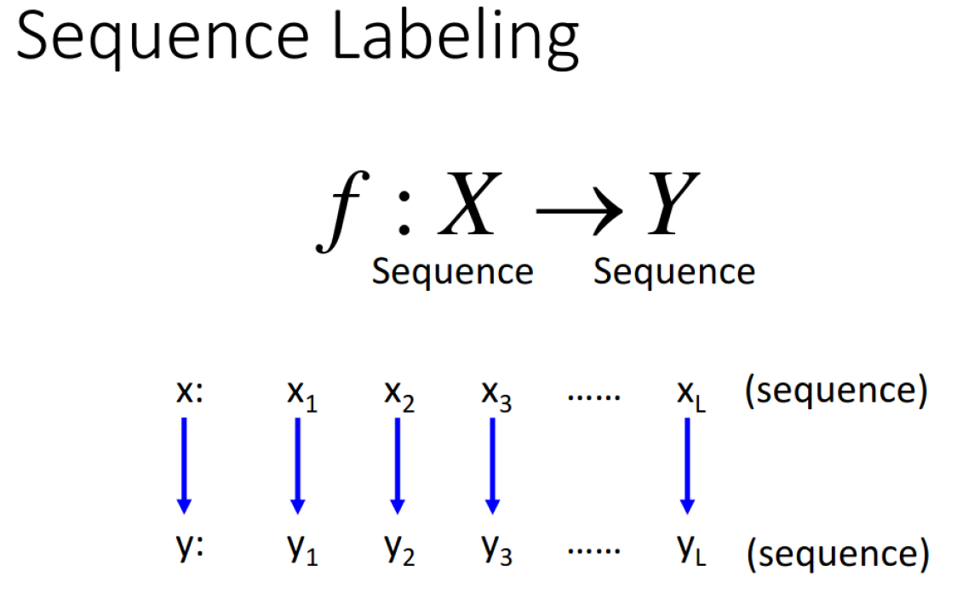
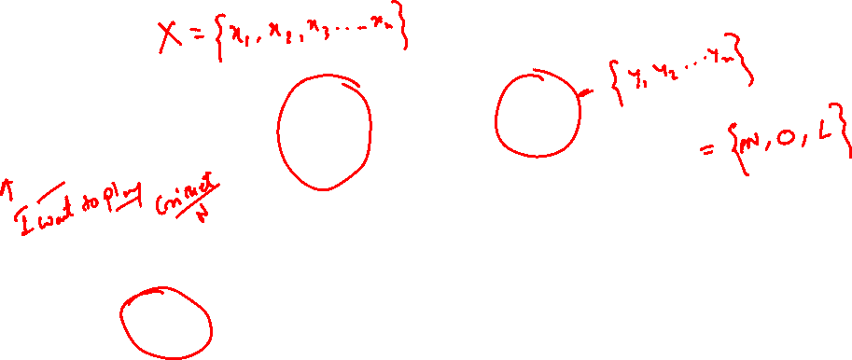

Slide 12
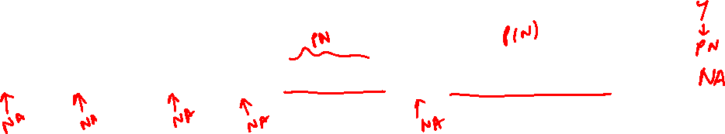
Identify the Person Name
what movies starred both al pacino and robert Ideniro
O what O movies O starred O both B-ACTOR al I-ACTOR pacino O and B-ACTOR robert ACTOR-Ideniro

Slide 13
Example Annotation
O what O movies O star O bruce I-ACTOR willis
O show O mestar B-ACTOR O films O with B-ACTOR drew I-ACTOR barrymore O from O the B-YEAR 1980s
O find O me O all O of O the O movies O that O starred B-ACTOR harold I-ACTOR ramis O and B-ACTOR bill I-ACTOR murray
O find O me O a O movie O with O a O quote O about O baseball O in O it
O what O movies O have B-TITLE mississippi O in O the O title

Slide 14
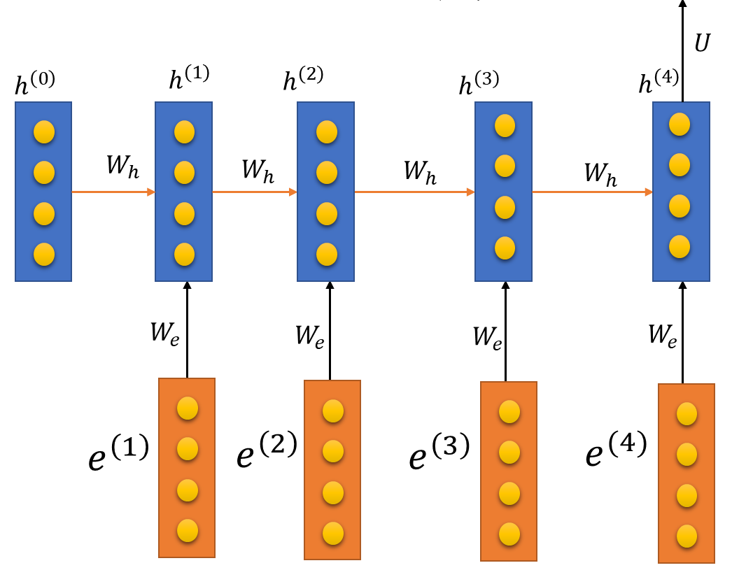

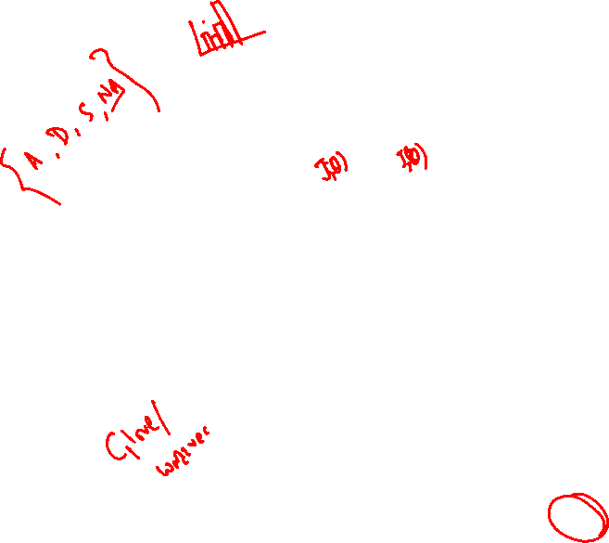








LSTM model for NER Recognition
o o o B-ACTOR I-ACTOR
$${\hat{y}}^{(1)}$$
$${\hat{y}}^{(2)}$$
$${\hat{y}}^{(3)}$$
$${\hat{y}}^{(4)}$$
$${\hat{y}}^{(5)}$$
$$σ$$
$$σ$$
$$σ$$
$$σ$$
Dense
Dense
Dense
Dense
Dropout
Dropout
Dropout
Dropout
…
…
What movies star Bruce Willis

Slide 15

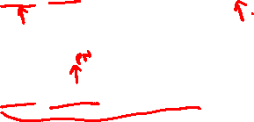








Bi-LSTM model for NER Recognition
PN o o o FN
$${\hat{y}}^{(1)}$$
$${\hat{y}}^{(2)}$$
$${\hat{y}}^{(3)}$$
$${\hat{y}}^{(4)}$$
$${\hat{y}}^{(5)}$$
The best time to visit is during May when you can see both the red Rhododendrons as well as the snow, it is also considered as a holy month.
Rose rose to put rows of roses.
I met Paris at Paris
John Hopkins University
$$σ$$
$$σ$$
$$σ$$
$$σ$$
Dense
Dense
Dense
Dense
Dropout
Dropout
Dropout
Dropout
…
…
Rose rose to put rows of roses.

Slide 16
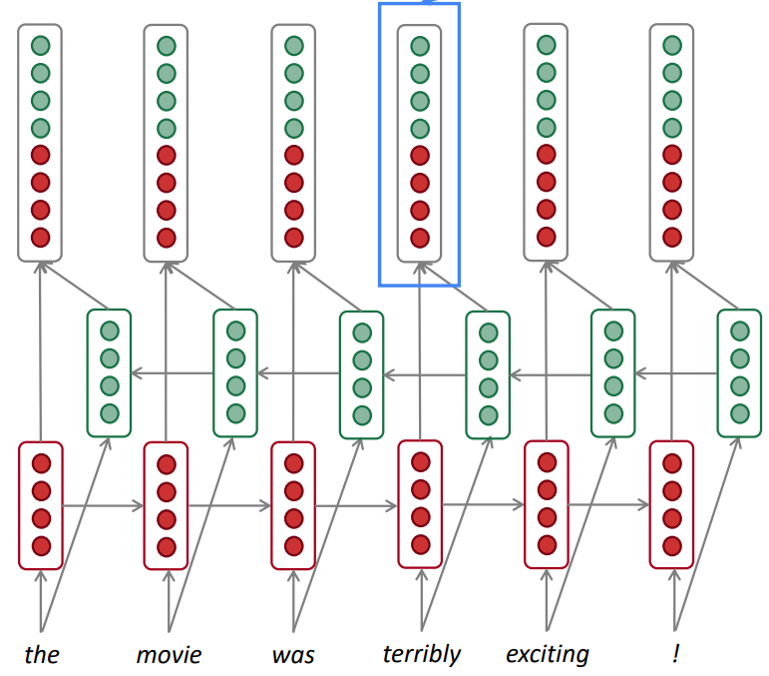
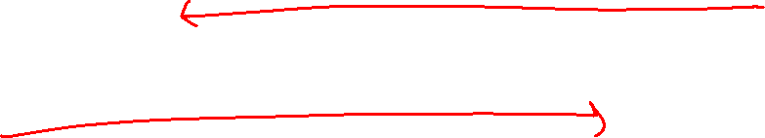
Bi-Directional RNN
Concatenated hidden states
This contextual representation of “Rose” has both left and right context!
Backward RNN
Forward RNN
Rose rose to put rows of roses.

Slide 17
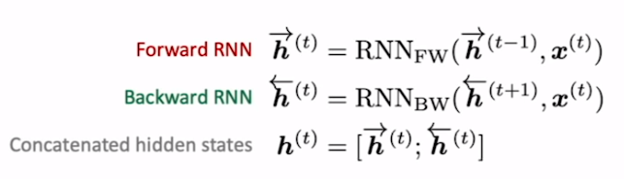
Bidirectional RNNs
This is a general notation to mean “compute one forward step of the RNN” – it could be a vanilla, LSTM or GRU computation.
On timestep t:
Generally, these two RNNs have separate weights
We regard this as “the hidden state” of a bidirectional RNN. This is what we pass on to the next parts of the network.

Slide 18
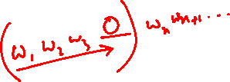
Bidirectional RNNs
Only applicable if you have access to the entire input sequence.
They are not applicable to Language Modeling, because in LM you only have left context available.
If you do have entire input sequence (e.g. any kind of encoding), bidirectionality is powerful (you should use it by default).
For example, BERT (Bidirectional Encoder Representations from Transformers) is a powerful pretrained contextual representation system built on bidirectionality. • You will learn more about BERT later in the course!

Slide 19
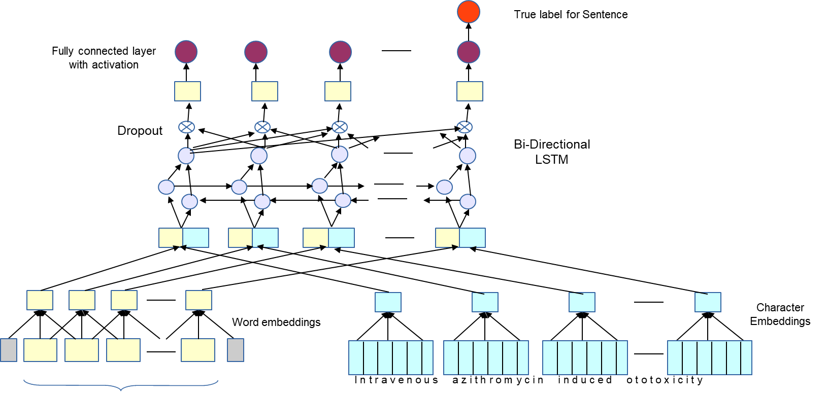

RNNs with Character Embeddings
An episode of subacute encephalopathy after the infusion of a moderate dose of methotrexate (1500 mg/m2) (MTX) is reported in a young adult with metastastic gastric cancer.
… subacute encephalopathy … 1500 mg/m2…

Slide 20


Incorporating Additional Linguistic Features with RNNs
Rose rose to put rows of roses.
(Noun) (verb) (Det) (Verb) (Noun) (PRP) (Noun).
Rose rose to put rows of roses.
(Noun) (verb) (Det) (Verb) (Noun) (PRP) (Noun).

Slide 21
Crime Information Extraction

Slide 22
Example News Text
Multiple teams of Gandhinagar police's local crime branch (LCB) arrested Shailesh Patel, one of the two prime accused in the Navin Shah kidnapping-murder case, and also seized the SUV in which the murder took place. Shah, 69, was director of printing of Navneet Education and was killed in a moving car on July 25 on SG Road. The LCB officials said that Patel was caught when he went to the spot where he had parked his another car used in the crime on Prantij-Himmatnagar Road. According to the LCB officials, four teams, led by inspector J D Purohit and sub-inspectors H K Solanki, K A Patel and S B Padheriya, are working on the case. After the arrest of two accused — Jignesh Bhavsar and Ramesh Patel — by Ahmedabad city crime branch, LCB seized a car parked by Shailesh Patel outside Devnarayan Dhaba, a roadside eatery, on Monday.

Slide 23

System Predicted Output
Standard NER Output
Multiple teams of Gandhinagar police's local crime branch (LCB) arrested Shailesh Patel, one of the two prime accused in the Navin Shah kidnapping-murder case, and also seized the SUV in which the murder took place. Shah, 69, was director of printing of Navneet Education and was killed in a moving car on July 25 on SG Road. The LCB officials said that Patel was caught when he went to the spot where he had parked his another car used in the crime on Prantij-Himmatnagar Road. According to the LCB officials, four teams, led by inspector J D Purohit and sub-inspectors H K Solanki, K A Patel and S B Padheriya, are working on the case. After the arrest of two accused — Jignesh Bhavsar and Ramesh Patel — by Ahmedabad city crime branch, LCB seized a car parked by Shailesh Patel outside Devnarayan Dhaba, a roadside eatery, on Monday.
Multiple teams of Gandhinagar police's local crime branch (LCB) arrested Shailesh Patel, one of the two prime accused in the Navin Shah kidnapping-murder case, and also seized the SUV in which the murder took place. Shah, 69, was director of printing of Navneet Education and was killed in a moving car on July 25 on SG Road. The LCB officials said that Patel was caught when he went to the spot where he had parked his another car used in the crime on Prantij-Himmatnagar Road. According to the LCB officials, four teams, led by inspector J D Purohit and sub-inspectors H K Solanki, K A Patel and S B Padheriya, are working on the case. After the arrest of two accused — Jignesh Bhavsar and Ramesh Patel — by Ahmedabad city crime branch, LCB seized a car parked by Shailesh Patel outside Devnarayan Dhaba, a roadside eatery, on Monday.
Law enforcement
Criminal Name
Action taken
Victim Name
Nature of crime
Crime Location

Slide 24
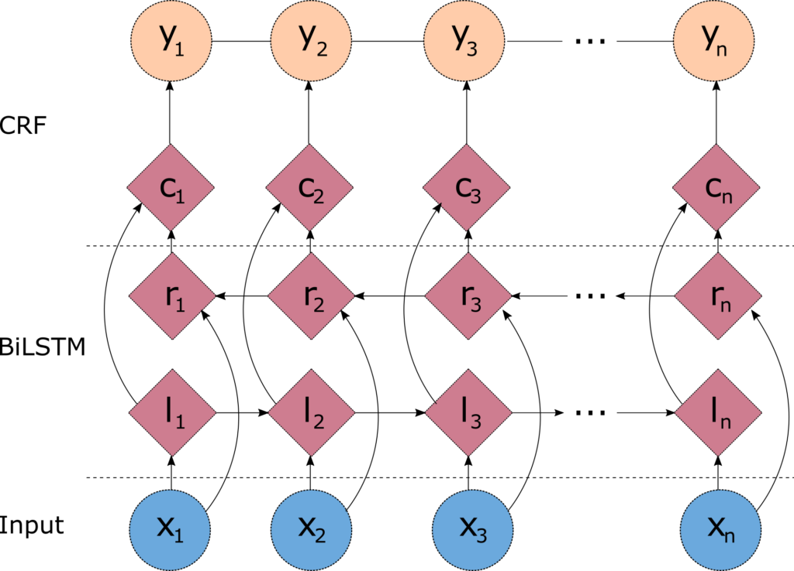
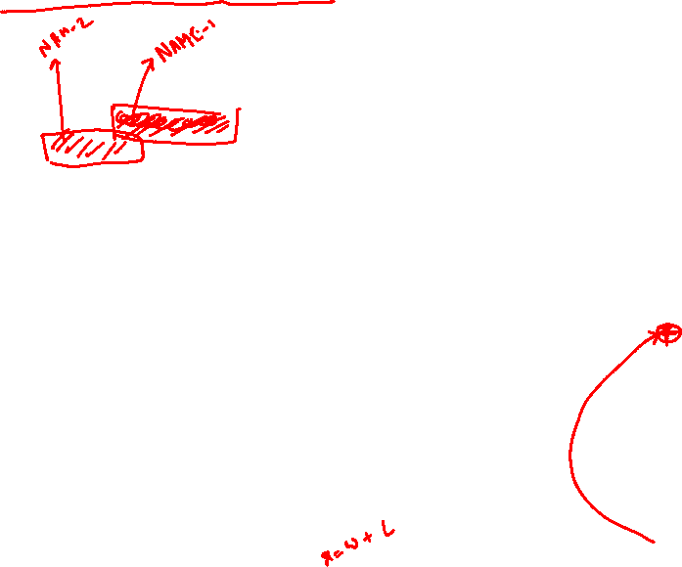




Bi-LSTM-CRF model for Crime Information Extraction
CRIME o ACCUSED VICTIM
Multiple teams of Gandhinagar police's local crime branch (LCB) arrested Shailesh Patel, one of the two prime accused in the Navin Shah kidnapping-murder case, and also seized the SUV in which the murder took place. Shah, 69, was director of printing of Navneet Education and was killed in a moving car on July 25 on SG Road. The LCB officials said that Patel was caught when he went to the spot where he had parked his another car used in the crime on Prantij-Himmatnagar Road. According to the LCB officials, four teams, led by inspector J D Purohit and sub-inspectors H K Solanki, K A Patel and S B Padheriya, are working on the case. After the arrest of two accused — Jignesh Bhavsar and Ramesh Patel — by Ahmedabad city crime branch, LCB seized a car parked by Shailesh Patel outside Devnarayan Dhaba, a roadside eatery, on Monday.
$$σ$$
$$σ$$
$$σ$$
$$σ$$
Dense
Dense
Dense

Slide 25

Bi-LSTM-CRF model for Crime Information Extraction
CRIME o ACCUSED VICTIM
Multiple teams of Gandhinagar-LOC1 police's local crime branch (LCB) arrested Shailesh Patel-NAME1, one of the two prime accused in the Navin Shah-NAME2 kidnapping-murder case, and also seized the SUV in which the murder took place. Shah, 69, was director of printing of Navneet Education and was killed in a moving car on July 25-TIME1 on SG Road-LOC2. The LCB officials said that Patel was caught when he went to the spot where he had parked his another car used in the crime on Prantij-Himmatnagar Road-LOC3. According to the LCB officials, four teams, led by inspector J D Purohit-NAME3 and sub-inspectors H K Solanki-NAME4, K A Patel-NAME5 and S B Padheriya-NAME6, are working on the case. After the arrest of two accused — Jignesh Bhavsar-NAME6 and Ramesh Patel-NAME7 — by Ahmedabad-LOC4 city crime branch, LCB seized a car parked by Shailesh Patel-NAME1 outside Devnarayan Dhaba, a roadside eatery, on Monday-TIME2.
$$σ$$
$$σ$$
$$σ$$
$$σ$$
Dense
Dense
Dense

Slide 26
Multi-layer RNNs
LM task: When she tried to print her tickets, she found that the printer was out of toner. She went to the stationery store to buy more toner. It was very overpriced. After installing the toner into the printer, she finally printed her ________
To learn from this training example, the RNN-LM needs to model the dependency between “tickets” on the 7th step and the target word “tickets” at the end.

Slide 27
Multi-layer RNNs
RNNs are already “deep” on one dimension (they unroll over many timesteps)
We can also make them “deep” in another dimension by applying multiple RNNs – this is a multi-layer RNN.
This allows the network to compute more complex representations
The lower RNNs should compute lower-level features and the higher RNNs should compute higher-level features.
Multi-layer RNNs are also called stacked RNNs.

Slide 28
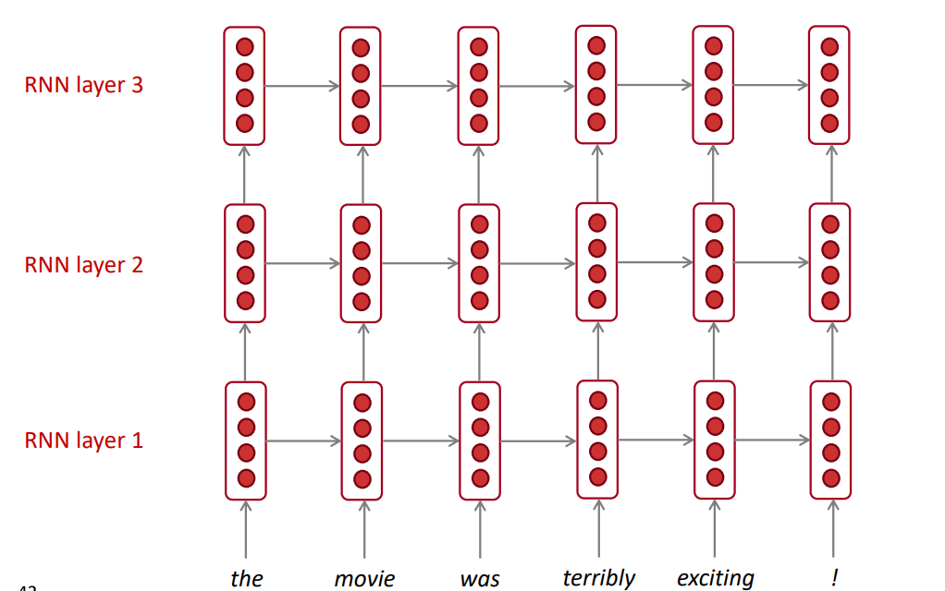
Multi-layer RNNs
The hidden states from RNN layer i are the inputs to RNN layer i+1

Slide 29
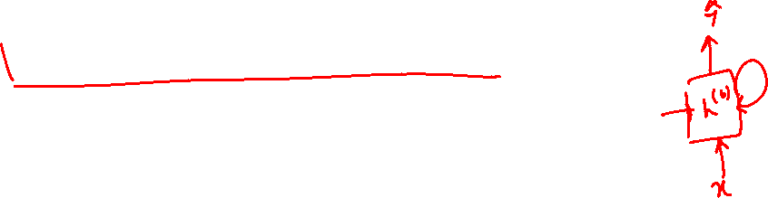
Limitations of LSTM
Long range dependency
Vanishing gradient still a problem
Large # of training steps
Recurrence prevents parallel computations

Slide 30
Attention Model Motivation
I have bought and returned three of these units now. Each one has been defective, and finally I just gave up on returning the system. The DVD player constantly gives "Bad Disc" errors and skips if there is even the slightest smudge on a disc. The sound quality is very nice for the price, but since the player doesn't work, it's essentially useless. This is a complete rip-off at any price point

Slide 31
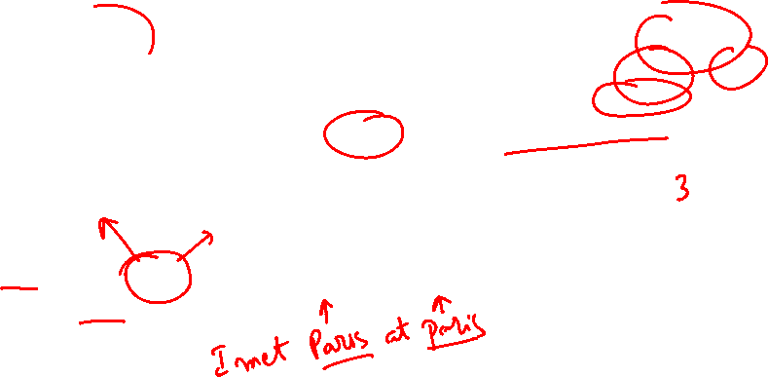
Attention Model Motivation
I have bought and returned three of these units now. Each one has been defective, and finally I just gave up on returning the system. The DVD player constantly gives "Bad Disc" errors and skips if there is even the slightest smudge on a disc. The sound quality is very nice for the price, but since the player doesn't work, it's essentially useless. This is a complete rip-off at any price point
NER Problem
The best time to visit is during May when you can see both the red Rhododendrons as well as the snow, it is also considered as a holy month.

Slide 32






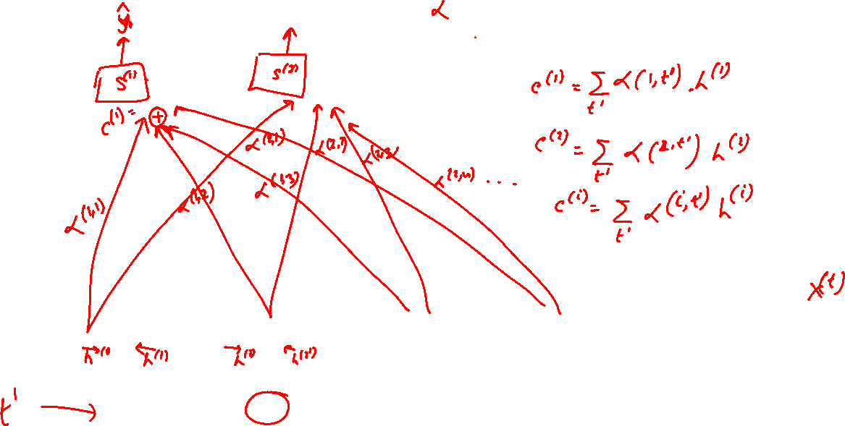
Attention Model
$$h^{(0)}$$
$$x^{(1)}$$
$$x^{(2)}$$
$$x^{(3)}$$
$$x^{(4)}$$
$$x^{(5)}$$

Slide 33

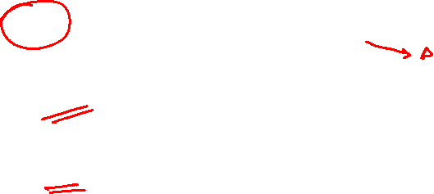







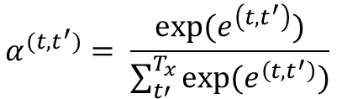

Attention Model
$$α^{(t,t^{′})}=amount of attention y^{(t)} should pay to h^{(t^{′})}$$
$$α^{(t,t^{′})}= \frac{exp⁡(e^{\left(t,t^{′}\right)})}{\sum_{t′}^{T_{x}}{exp⁡(e^{\left(t,t^{′}\right)})}}$$
$${\hat{y}}^{(t−1)}$$
$${\hat{y}}^{(t)}$$
$$S^{(t−1)}$$
$$S^{(t)}$$
$$s^{(t−1)}$$
$$e^{(t,t^{′})}$$
+
$$h^{(t′)}$$
$$h^{(0)}$$
$$x^{(1)}$$
$$x^{(2)}$$
$$x^{(3)}$$
$$x^{(t−1)}$$
$$x^{(t)}$$

Slide 34
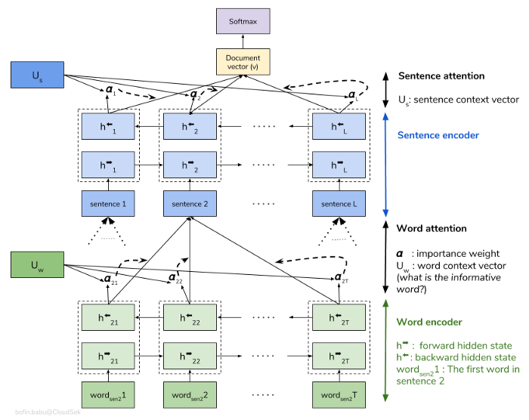
Hierarchical Attention Network (HAN)
Words make sentences and sentences make documents

Slide 35
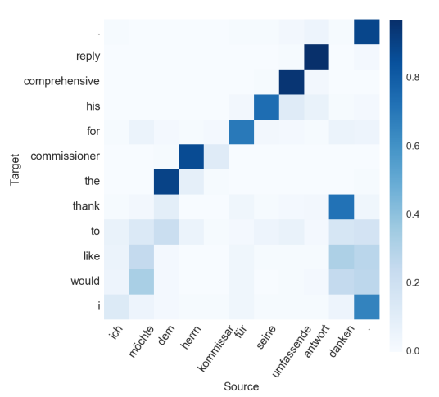

Attention Visualization
Machine Translation
Sentiment Classification

Slide 36

Sequence-to-Sequence Modeling

Slide 37


















Conditional LM
Language Model
Machine Translation
$${\hat{y}}^{(1)}$$
$${\hat{y}}^{(2)}$$
$${\hat{y}}^{(T)}$$
$${\hat{y}}^{(1)}$$
$${\hat{y}}^{(2)}$$
$${\hat{y}}^{(T)}$$
$$h^{(0)}$$
$$h^{(1)}$$
$$h^{(0)}$$
$$h^{(1)}$$
$$x^{(1)}$$
$$x^{(1)}$$
$$x^{(1)}$$
$${\hat{y}}^{(T)}$$
$${\hat{y}}^{(1)}$$
$${\hat{y}}^{(2)}$$
$${\hat{y}}^{(T)}$$
$$h^{(0)}$$
$$h^{(1)}$$
$$h^{(∗)}$$
$$h^{(1)}$$
$$x^{(1)}$$
$$x^{(1)}$$
$$x^{(1)}$$

Slide 38
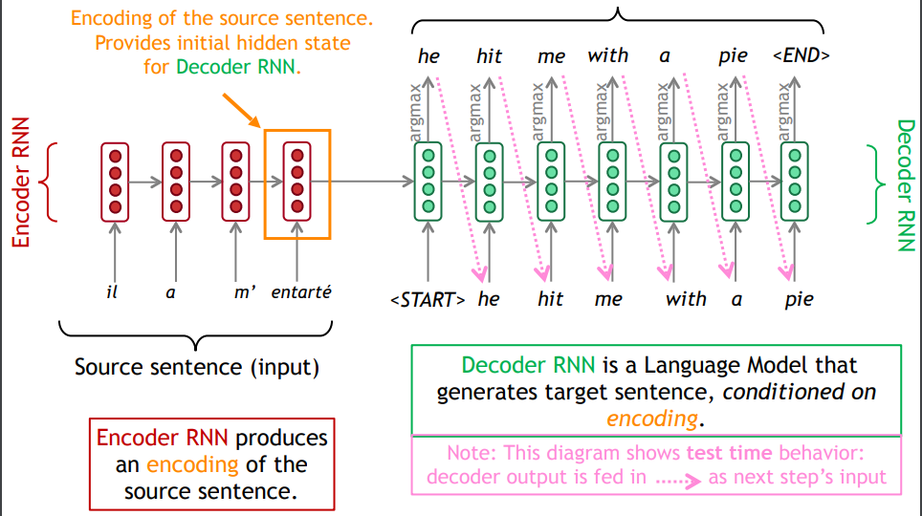
Neural Seq-Seq Generation Model

Slide 39
Sequence-to-Sequence Modeling
Introduce a new task: Machine Translation
Introduce a new neural architecture: sequence-to-sequence
Introduce a new neural technique: attention

Slide 40
Sequence-to-sequence is versatile!
Sequence-to-sequence is useful for more than just MT
Many NLP tasks can be phrased as sequence-to-sequence:
Summarization (long text → short text)
Dialogue (previous utterances → next utterance)
Parsing (input text → output parse as sequence)
Code generation (natural language → Python code)
Also used in Computer Vision
Image description generation

Slide 41
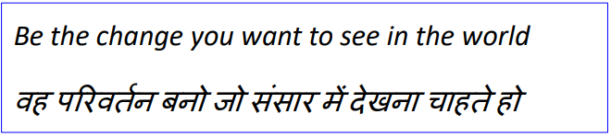
Machine Translation
Machine Translation (MT) is the task of translating a sentence x from one language (the source language) to a sentence y in another language (the target language).

Slide 42
1950s: Early Machine Translation
Machine Translation research began in the early 1950s.
Russian → English (motivated by the Cold War!)
Systems were mostly rule-based, using a bilingual dictionary to map Russian words to their English counterparts
https://www.youtube.com/watch?v=K-HfpsHPmvw

Slide 43


1990s-2010s: Statistical Machine Translation
Core idea: Learn a probabilistic model from data
Suppose we’re translating French → English.
We want to find best English sentence y, given French sentence x
Use Bayes Rule to break this down into two components to be learnt separately

Slide 44
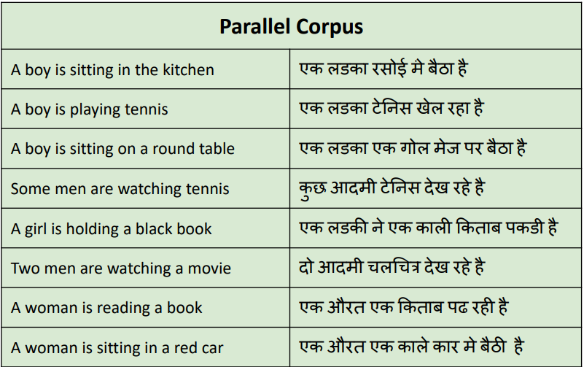
Building a MT System
Question: How to learn translation model ?
First, need large amount of parallel data (e.g. pairs of human-translated Hindi/English sentences)

Slide 45

Learning alignment for SMT
Question: How to learn translation model from the parallel corpus?
Break it down further: Introduce latent a variable into the model:
where a is the alignment, i.e. word-level correspondence between source sentence x and target sentence y

Slide 46
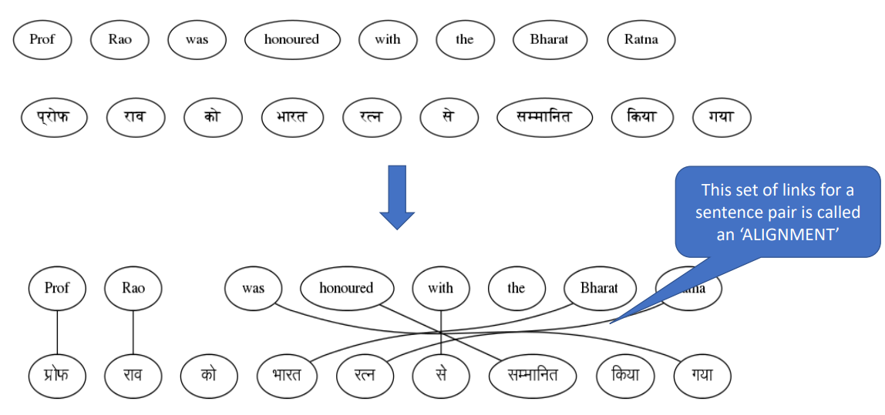

Slide 47
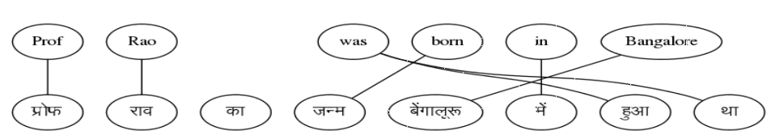
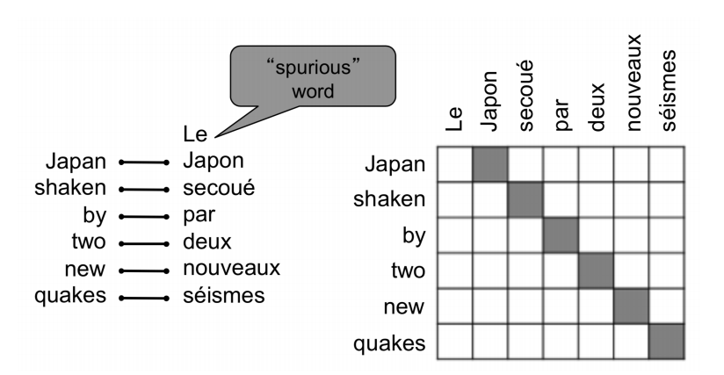
What is alignment?
Alignment is the correspondence between particular words in the translated sentence pair.
Typological differences between languages lead to complicated alignments!
Note: Some words have no counterpart

Slide 48
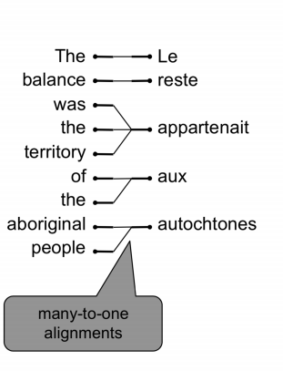
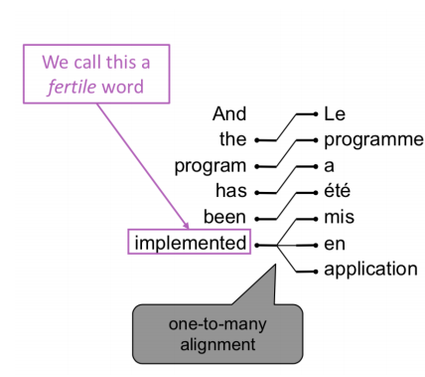
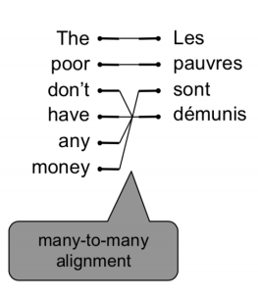
Alignment is complex
Alignment can be many-to-one
Alignment can be one-to-many
Alignment can be many-to-many (phrase-level)

Slide 49
Learning alignment for SMT
We learn P(x,a|y) as a combination of many factors, including:
Probability of particular words aligning (also depends on position in sent)
Probability of particular words having particular fertility (number of corresponding words)
Alignments a are latent variables: They aren’t explicitly specified in the data!
Require the use of special learning algos (like Expectation Maximization) for learning the parameters of distributions with latent variables.

Slide 50

Decoding for SMT
We could enumerate every possible y and calculate the probability? → Too expensive!
Answer: Impose strong independence assumptions in model, use dynamic programming for globally optimal solutions (e.g. Viterbi algorithm).
This process is called decoding

Slide 51
What is Neural Machine Translation?
Neural Machine Translation (NMT) is a way to do Machine Translation with a single neural network
The neural network architecture is called sequence-to-sequence (aka seq2seq) and it involves two RNNs.

Slide 52
Conditional LM
Language Model
Machine Translation
$${\hat{y}}^{(1)}$$
$${\hat{y}}^{(2)}$$
$${\hat{y}}^{(T)}$$
$${\hat{y}}^{(1)}$$
$${\hat{y}}^{(2)}$$
$${\hat{y}}^{(T)}$$
$$h^{(0)}$$
$$h^{(1)}$$
$$h^{(0)}$$
$$h^{(1)}$$
$$x^{(1)}$$
$$x^{(1)}$$
$$x^{(1)}$$
$${\hat{y}}^{(T)}$$
$${\hat{y}}^{(1)}$$
$${\hat{y}}^{(2)}$$
$${\hat{y}}^{(T)}$$
$$h^{(0)}$$
$$h^{(1)}$$
$$h^{(∗)}$$
$$h^{(1)}$$
$$x^{(1)}$$
$$x^{(1)}$$
$$x^{(1)}$$

Slide 53
Neural Seq-Seq Generation Model

